Slide 1
AEM 2210
Financial Accounting
Chapter 05: Communicating and Interpreting Accounting Information
Professor Sinclair
Spring 2018

Slide 2
Chapter 05 Learning Objectives
Recognize the people involved in the accounting communication process (regulators, managers, directors, auditors, information intermediaries, and users), their roles in the process, and the guidance they receive from legal and professional standards.
Identify the steps in the accounting communication process, including the issuance of press releases, annual reports, quarterly reports, and SEC filings, as well as the role of electronic information services in this process.
Recognize and apply the different financial statement and disclosure formats used by companies in practice and analyze the gross profit percentage.
Analyze a company’s performance based on return on assets and its components and the effects of transactions on financial ratios.

Slide 3
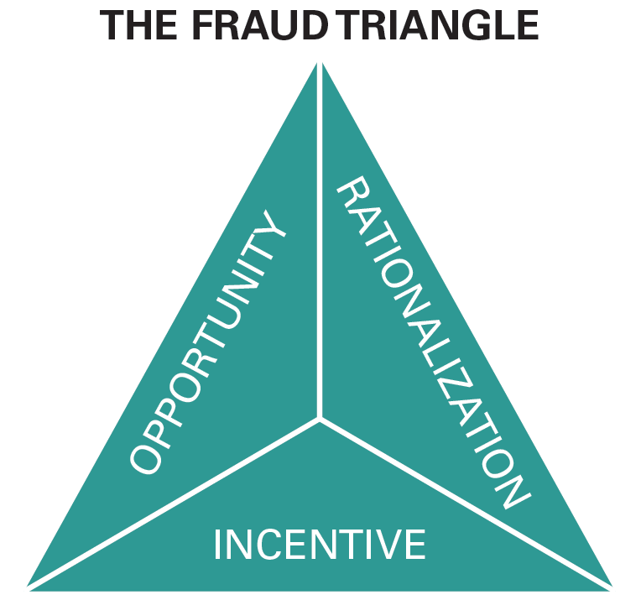
Corporate Governance
Most businesses invest in corporate governance: procedures designed to ensure that the company is managed in the interests of the shareholders. Much of the corporate governance system is aimed at ensuring integrity in the financial reporting process.
In an attempt to restore investor confidence after a series of high-profile accounting failures, Congress passed the Public Accounting Reform and Investor Protection Act (the Sarbanes-Oxley Act ), which strengthened financial reporting and corporate governance for public companies.
Three conditions are necessary for financial statement fraud to occur:
an incentive to commit fraud
the opportunity to commit fraud
the ability to rationalize the misdeed
These conditions make up what antifraud experts call the fraud triangle. A good system of corporate governance is designed to address these conditions.

Slide 4

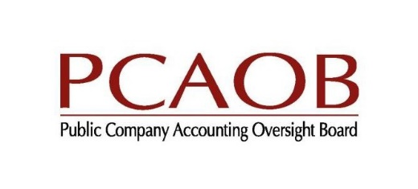

Corporate Governance
Regulators:
U.S. Securities and Exchange Commission (SEC): protects investors and maintain the integrity of the securities markets.
Financial Accounting Standards Board (FASB): sets generally accepted accounting principles (GAAP)
Public Company Accounting Oversight Board (PCAOB): sets auditing standards for independent auditors (CPAs) of public companies

Slide 5
Corporate Governance
Managers:
The primary responsibility for the information in the financial statements and related disclosures lies with management, specifically the highest officer in the company, often called the chief executive officer (CEO), and the highest officer associated with the financial and accounting side of the business, often called the chief financial officer (CFO).
At all public companies, the CEO and CFO must personally certify that:
Each report filed with the SEC does not contain any untrue material statement or omit a material fact and fairly presents in all material respects the financial condition, results of operations, and cash flows of the company.
There are no significant deficiencies and material weaknesses in the internal controls over financial reporting.
They have disclosed to the auditors and audit committee of the board any weaknesses in internal controls or any fraud involving management or other employees who have a significant role in financial reporting.
Executives who knowingly certify false financial reports are subject to fines and prison terms. The accounting staff also bears professional responsibility for the accuracy of this information, although its legal responsibility is smaller.

Slide 6
Corporate Governance
Board of Directors (Audit Committee):
The board of directors is elected by the stockholders to represent their interests, and its audit committee is responsible for maintaining the integrity of the company’s financial reports.
The board of directors oversees the CEO and other senior management. The audit committee of the board, which must be composed of independent (non-management) directors with financial knowledge, is responsible for ensuring that processes are in place for maintaining the integrity of the company’s accounting, financial statement preparation, and financial reporting. It is responsible for hiring the company’s independent auditors. The committee meets separately with the auditors to discuss management’s compliance with their financial reporting responsibilities.

Slide 7
Corporate Governance
Auditors:
The SEC requires publicly traded companies to have their statements and their control systems over the financial reporting process audited by an independent registered public accounting firm (independent auditor) following auditing standards established by the PCAOB.
Many privately owned companies also have their statements audited.
By signing an unqualified (or clean) audit opinion, a CPA firm assumes part of the financial responsibility for the fairness of the financial statements and related presentations. This opinion, which adds credibility to the statements, is also often required by agreements with lenders and private investors.
Subjecting the company’s statements to independent verification reduces the risk that the company’s financial condition is misrepresented in the statements. As a result, rational investors and lenders should lower the rate of return (interest) they charge for providing capital.

Slide 8
Corporate Governance
Information Intermediaries:
Many investors rely on company websites, information services, and financial analysts to gather and analyze information. Companies actually file their SEC forms electronically through the EDGAR (Electronic Data Gathering and Retrieval) Service, which is sponsored by the SEC.
Most companies also provide direct access to their financial statements and other information over the Web. Financial analysts receive accounting reports and other information about companies from electronic services. They also gather information through conversations with company executives and visit company facilities and competitors.

Slide 9
Information Intermediaries

Slide 10
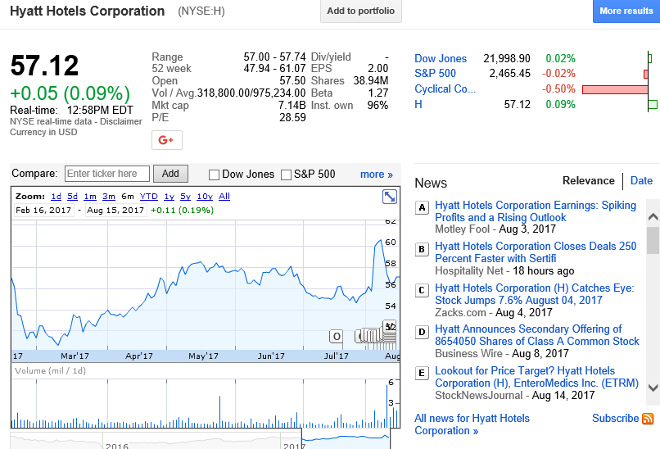
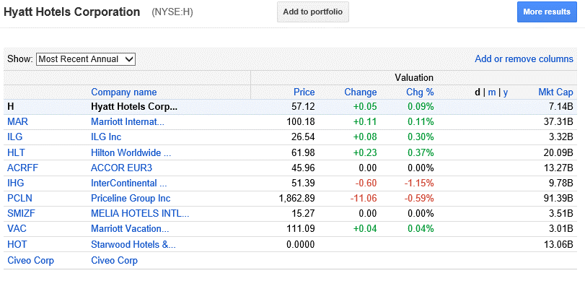
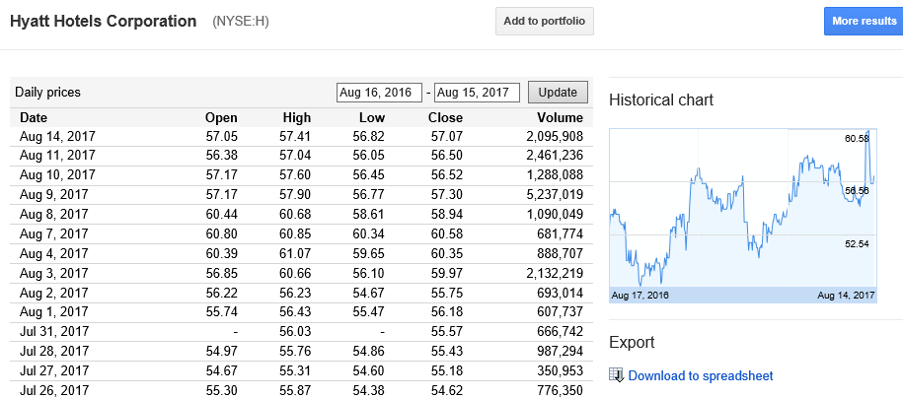
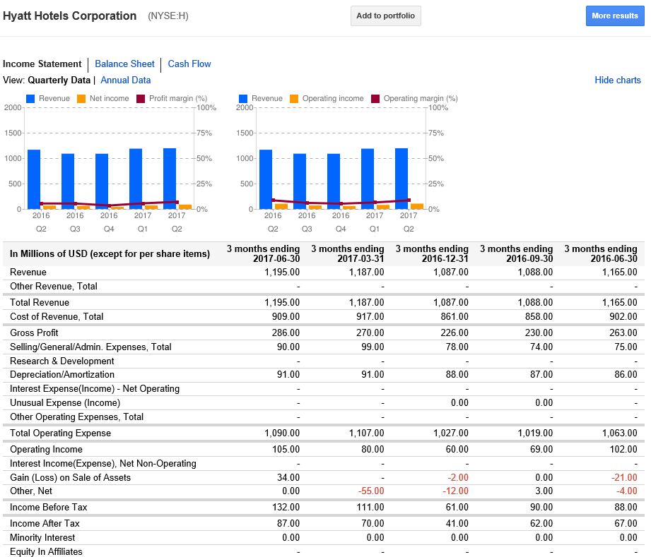
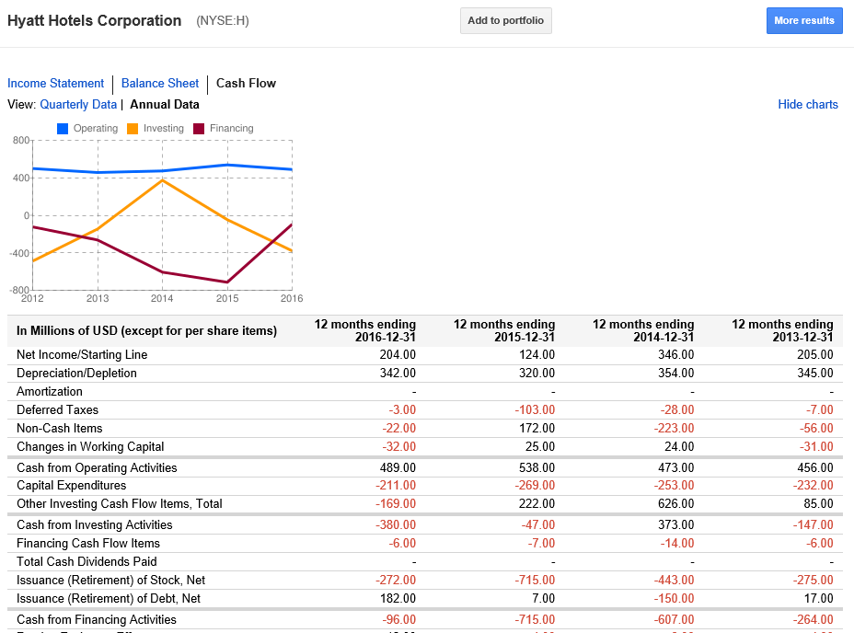
Google Finance

Slide 11
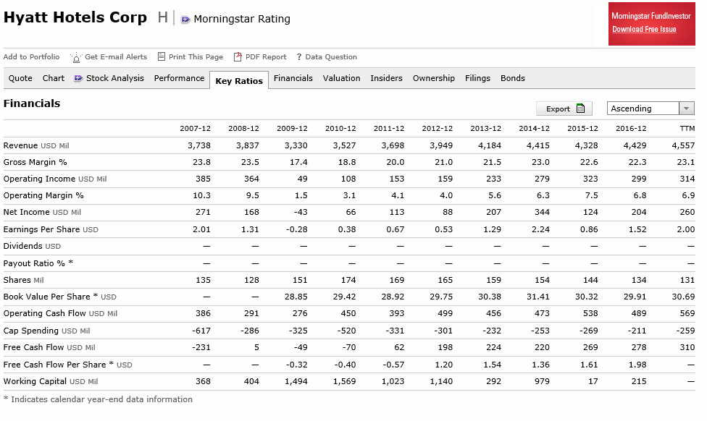
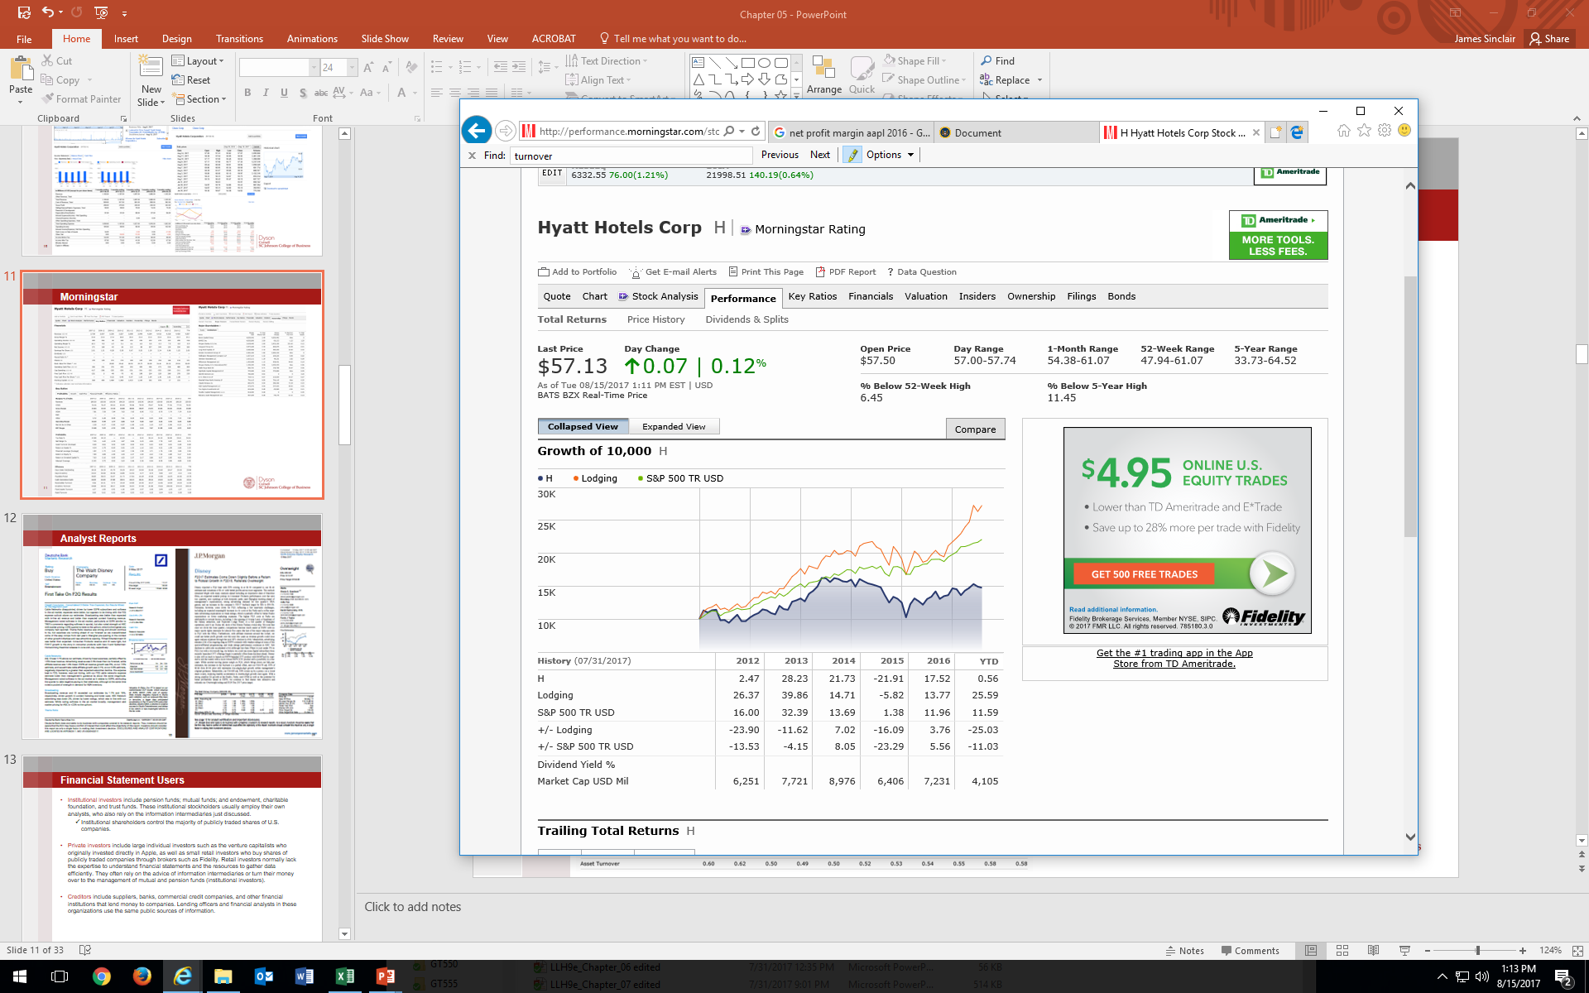
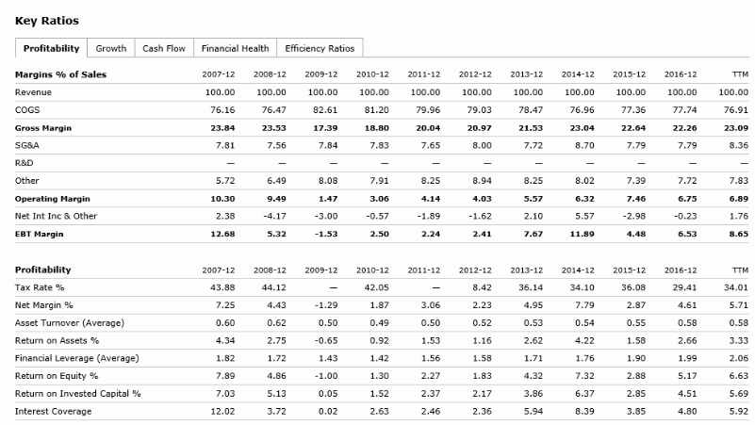
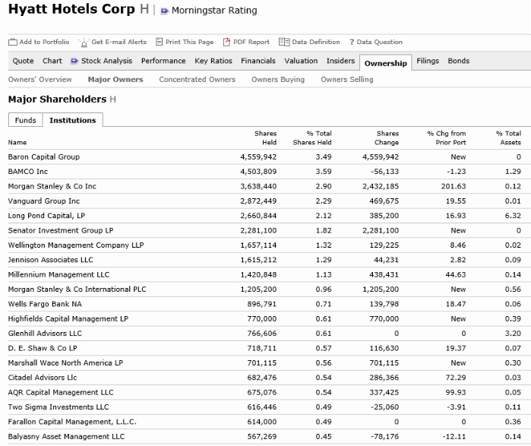
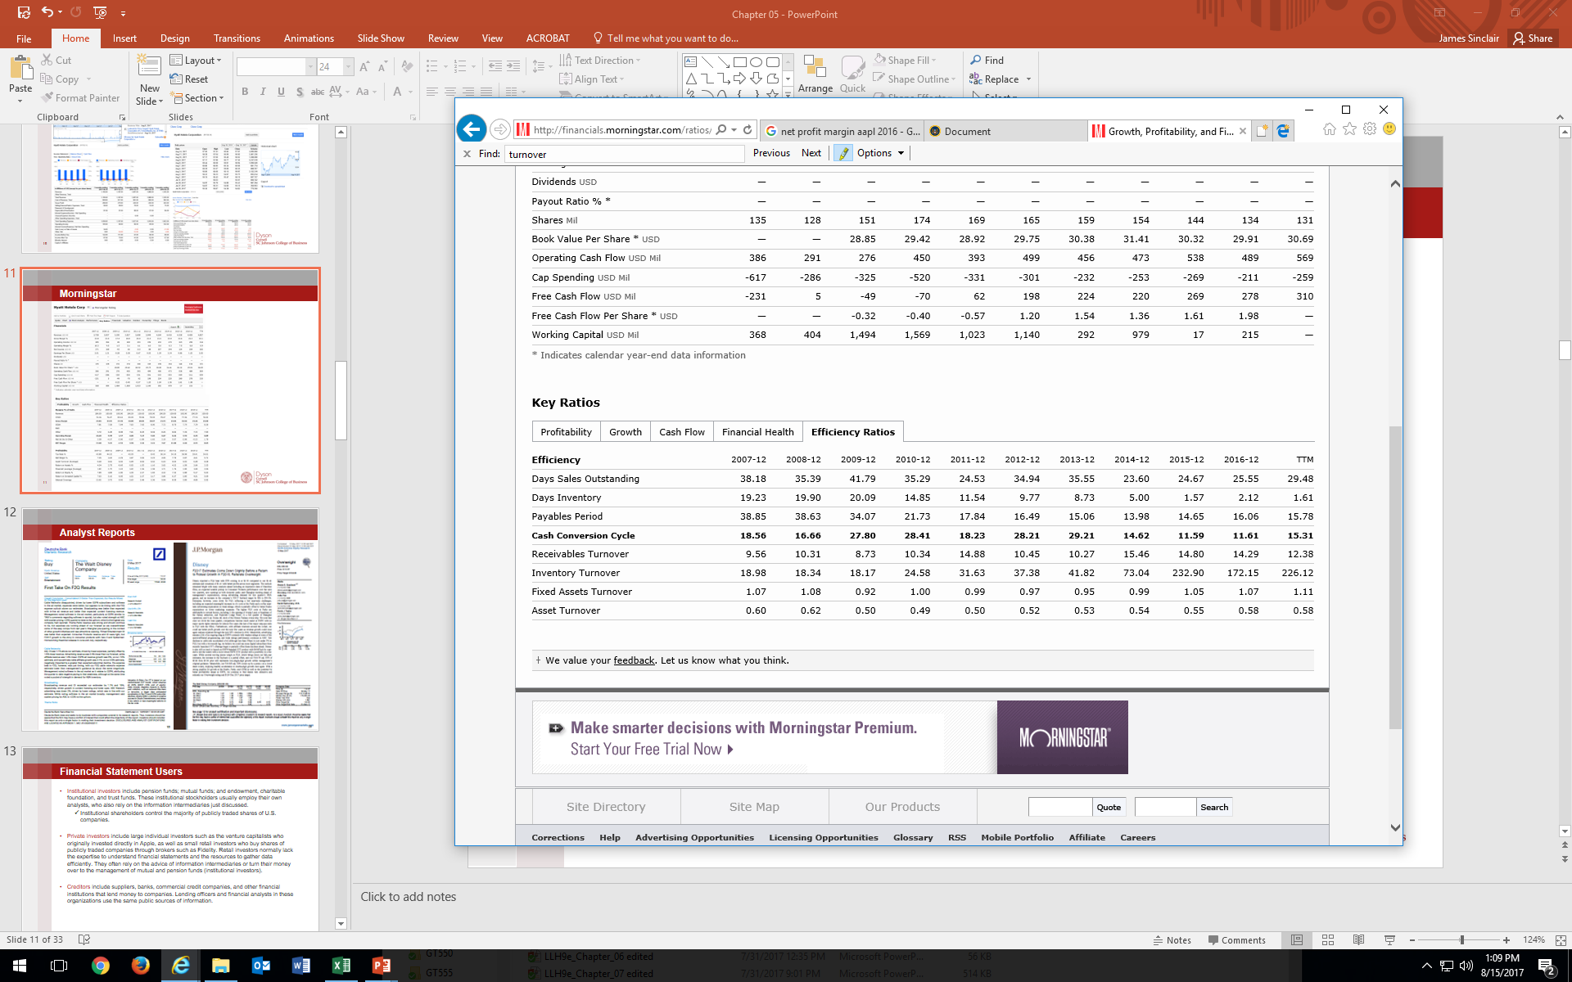
Morningstar

Slide 12
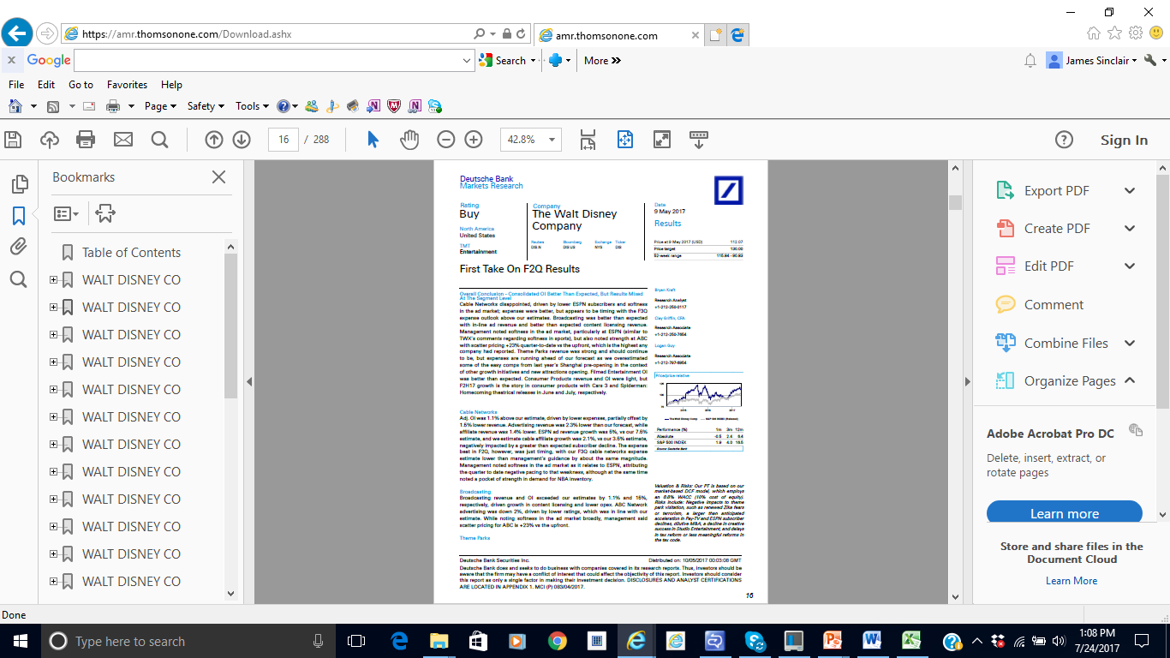
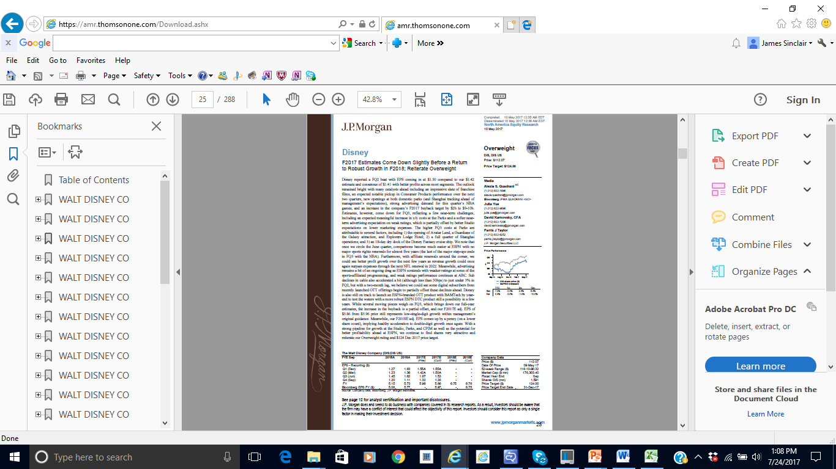
Analyst Reports

Slide 13
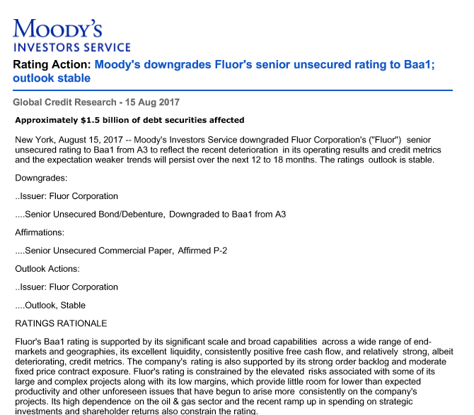
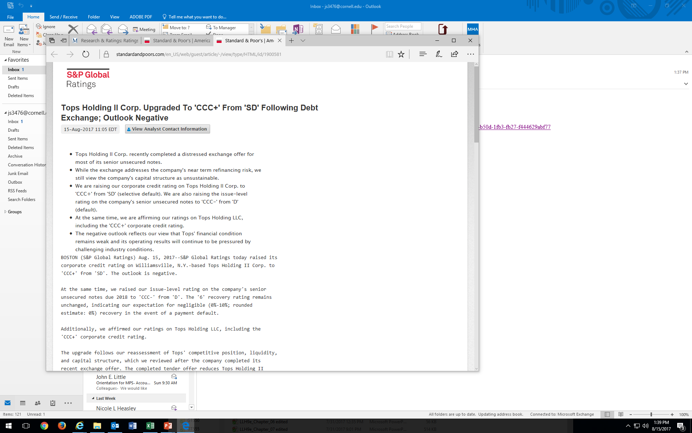
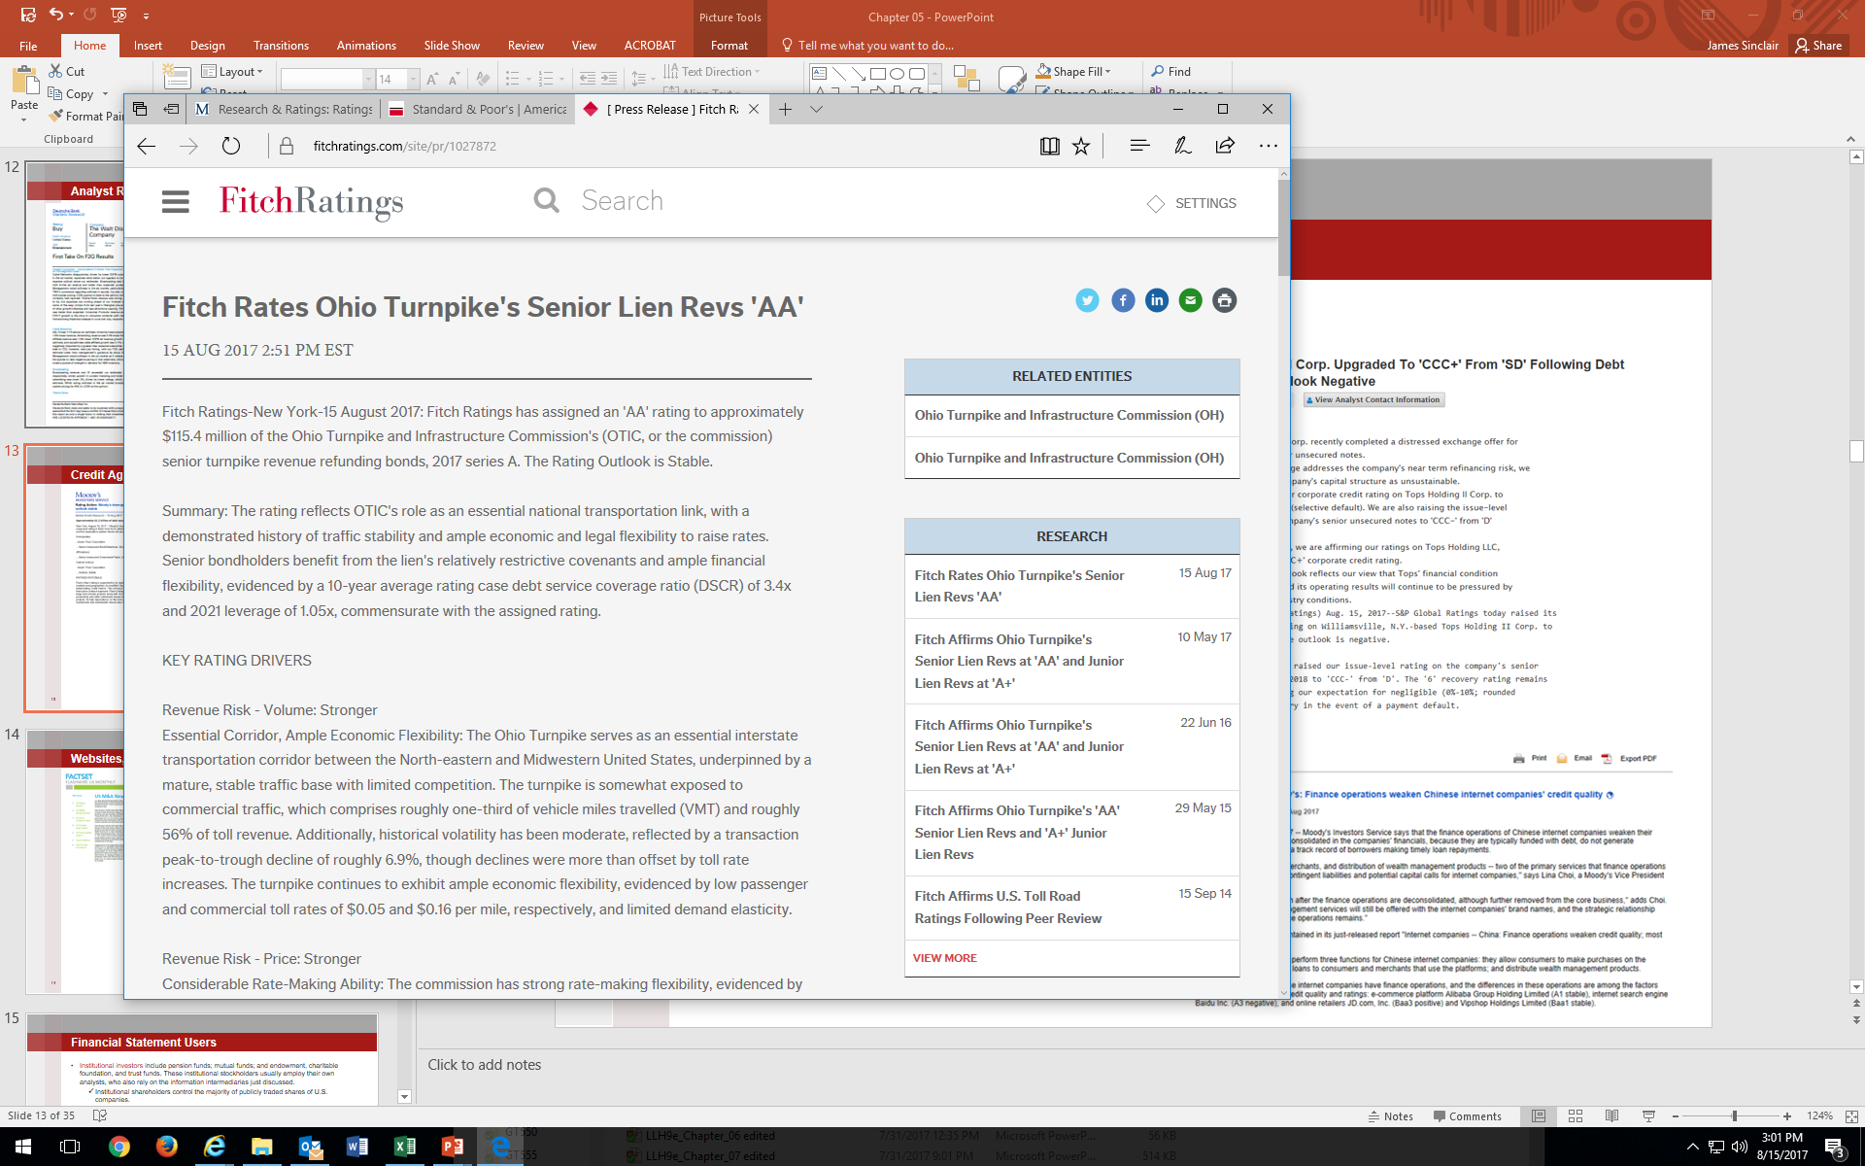
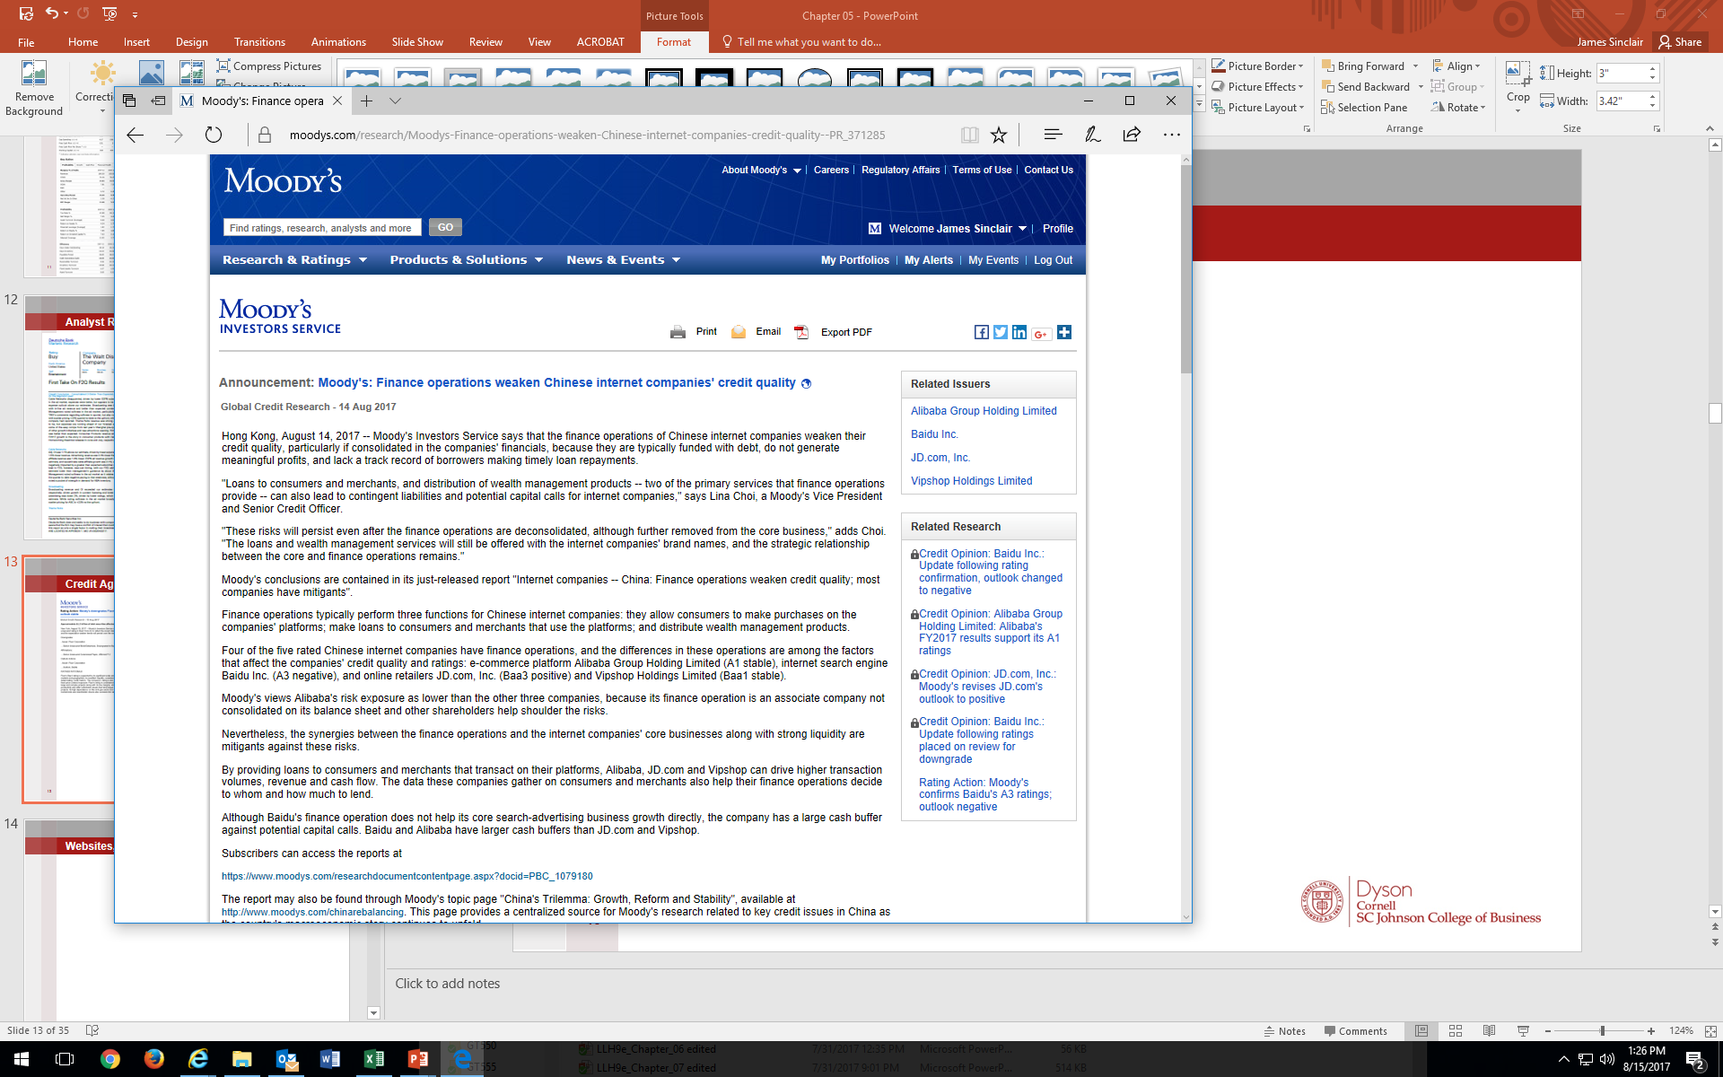
Credit Agency Reports

Slide 14
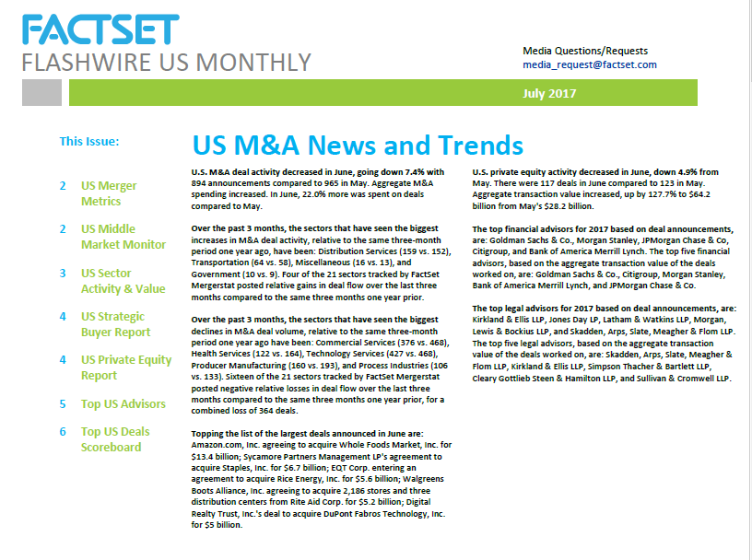
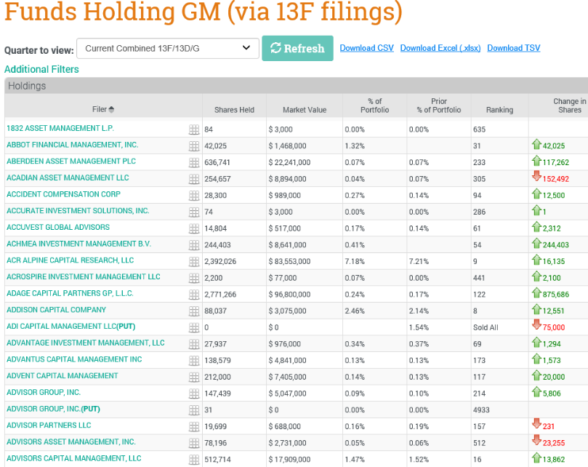
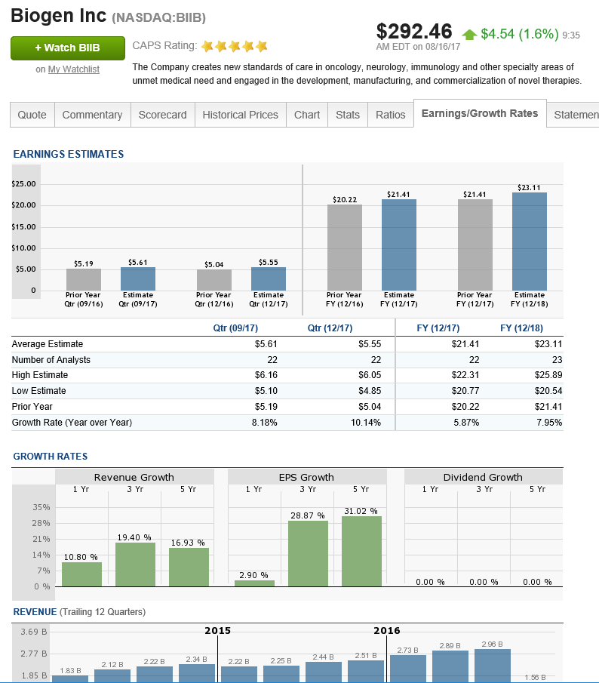
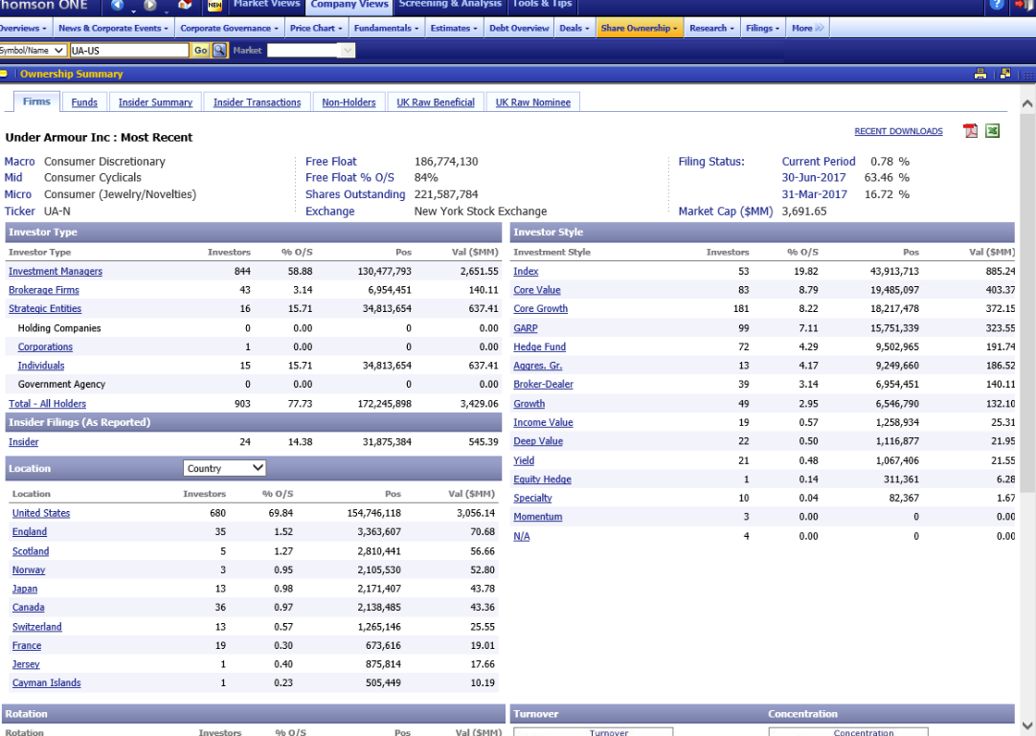
Websites, Blogs, Twitter, oh my…

Slide 15
Thomson ONE

Slide 16
Thomson One
Go to: https://johnson.library.cornell.edu/databases/thomson-one-ie-only
Works in Internet Explorer only.
Description:
Thomson One provides access to current and historical financial data, including financial statements, filings, stock prices, earnings estimates, M&A deals, private equity deals and more. Also access analyst reports and company profiles with SWOT (Strengths Weaknesses Opportunities and Threats) analyses. Screen for individuals to find portfolio managers, traders, and others in the field.
When To Use:
Use when you need data on public company finances, M&A activity, PE deals, and analyst reports. An Excel add-in is available for downloading large sets of data. Please contact the library reference staff for information about acquiring the add-in.

Slide 17
SEC Edgar

Slide 18
SEC Edgar
Go to: https://www.sec.gov/edgar/searchedgar/accessing-edgar-data.htm
Indexes to all public filings are available from 1994Q3 through the present:
https://www.sec.gov/Archives/edgar/daily-index/
daily index files through the current year
https://www.sec.gov/Archives/edgar/full-index/
Full indexes offer a "bridge" between quarterly and daily indexes, compiling filings from the beginning of the current quarter through the previous business day. At the end of the quarter, the full index is rolled into a static quarterly index.
Each directory and all subdirectories contain 3 files to assist in automated crawling of these directories.
index.html (the web browser would normally receive these)
index.xml (an XML structured version of the same content)
index.json (a JSON structured vision of the same content)
The EDGAR indexes list the following information for each filing: Company Name, Form Type, CIK (Central Index Key), Date Filed, and File Name (including folder path).
Four types of indexes are available. Each index contains the same information sorted differently.
company — sorted by company name
form — sorted by form type
master — sorted by CIK number
XBRL — list of submissions containing XBRL financial files, sorted by CIK number; these include Voluntary Filer Program submissions

Slide 19
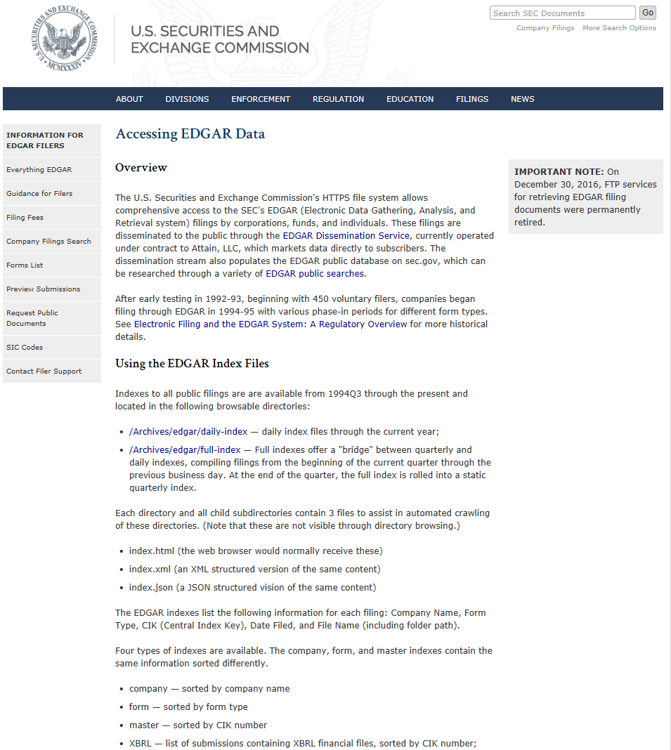
SEC Edgar

Slide 20
Financial Statement Users
Institutional investors include pension funds; mutual funds; and endowment, charitable foundation, and trust funds. These institutional stockholders usually employ their own analysts, who also rely on the information intermediaries just discussed.
Institutional shareholders control the majority of publicly traded shares of U.S. companies.
Private investors include large individual investors as well as small retail investors who buy shares of publicly traded companies through brokers such as Fidelity and Vanguard. Retail investors often lack the expertise to fully understand financial statements and the resources to gather data efficiently. They often rely on the advice of information intermediaries or turn their money over to the management of mutual and pension funds (institutional investors).
Creditors include suppliers, banks, commercial credit companies, and other financial institutions that lend money to companies. Lending officers and financial analysts in these organizations often rely upon the same public sources of information.
Governments; labor unions; researchers; managers; employees; competitors; regulatory agencies; customers; suppliers; lawyers; other interested market participants

Slide 21
Disclosure Process

Slide 22
Disclosure Process
The accounting communication process includes more steps and participants than one would envision in a world in which annual and quarterly reports are simply mailed to shareholders. SEC Regulation FD, for “Fair Disclosure,” requires that companies provide all investors equal access to all important company news. Managers and other insiders are also prohibited from trading their company’s shares based on nonpublic (insider) information so that no party benefits from early access.
To provide timely information to external users and to limit the possibility of selective leakage of information, public companies announce quarterly and annual earnings (audited for annual, and reviewed for quarterly, earnings) through a press release, often before the financial statements become publicly available through EDGAR. A typical earnings press release includes key financial figures, followed by management’s discussion of the results and condensed income statements and balance sheets.

Slide 23
Disclosure Process
For privately held companies, annual reports are relatively simple documents photocopied on white bond paper. They normally include only the following:
Four basic financial statements: income statement, balance sheet, stockholders’ equity or retained earnings statement, and cash flow statement.
Related notes (footnotes).
Report of Independent Accountants (Auditor’s Opinion) if the statements are audited.
The annual reports of public companies filed on Form 10-K are significantly more elaborate mainly because of additional SEC reporting requirements
The Form 10-K is the annual report that publicly traded companies must file with the SEC. This Form includes disclosures about the business and selected financial data, and provides a management discussion and supplemental data along with the financial statements.

Slide 24
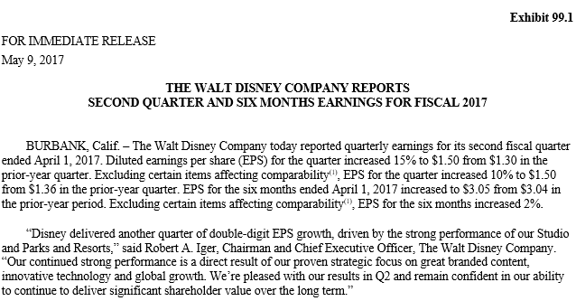

Earnings Announcement
Is this release good news or bad news for Disney? How should the market respond to this disclosure?

Slide 25
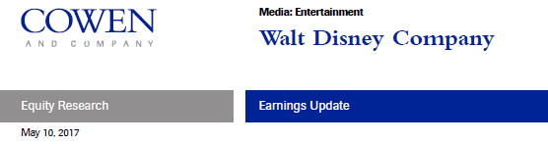
Earnings Announcement
The Cowen Insight
Disney reported FQ2 revenue that was below our estimates and consensus. However, reported EPS was above consensus. We are lowering our FY17 estimates (which were above consensus). We view DIS shares as somewhat aggressively valued and reiterate our Market Perform (2) rating.
Revenue Miss and EPS Beat vs. Consensus
Revenue of $13.34B (+3% y/y) was below both our $13.69B estimate and consensus $13.45B estimate, driven largely by Consumer Products revenues of $1.06B vs. our $1.21B estimate. Adjusted EPS of $1.50 (+10% y/y) came in below our $1.56 estimate but above consensus $1.41. Bottom line downside vs. our estimate was driven by lower than expected EBIT from Parks & Resorts (reported $750MM vs. our admittedly aggressive $871MM estimate) as well as lower contributions from movie-linked merchandise sales that impacted both CP and Studio Entertainment results.
Note: DIS did beat consensus expectations for EPS. This excerpt from Cowen does not reflect analyst consensus forecasts.
Is this release good news or bad news for Disney? How should the market respond to this disclosure?

Slide 26
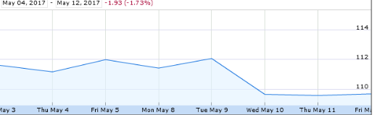
Market Reaction to Earnings Announcements
Walt Disney Co. (Ticker: DIS)
250-Day Trading Activity (July 26, 2016 - July 21, 2017)
Average Daily Return 0.04%
Average Absolute Daily Return 0.56%
May 10, 2017 EA Return (2.15%)
For actively-traded companies, stock market reactions to news happen quickly
The market reacts not to the amount of earnings, but to the difference between expected and actual earnings (unexpected earnings)

Slide 27
A Closer Look at Financial Statements

Slide 28
A Closer Look
There are three (3) additional characteristics of financial statements and related disclosures that make them more useful:
Comparative financial statements: Allow users to compare performance from period to period; companies report financial statement values for the current period and one or more prior periods.
Additional subtotals and classifications in financial statements: Companies may use slightly different statement formats to recognize key performance metrics.
Additional disclosures: Most companies present voluminous notes that are necessary to understand a company’s performance and financial condition.

Slide 29

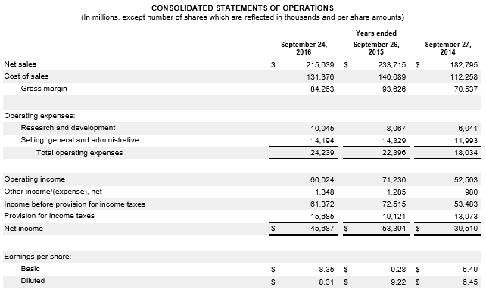
A Closer Look
The gross profit percentage is calculated by dividing gross profit by net sales. Gross profit is equal to Net Sales minus Cost of Goods Sold. The gross profit percentage measures a company’s ability to charge premium prices and produce goods and services at low cost. All other things equal, a higher gross profit results in higher net income.

Slide 30
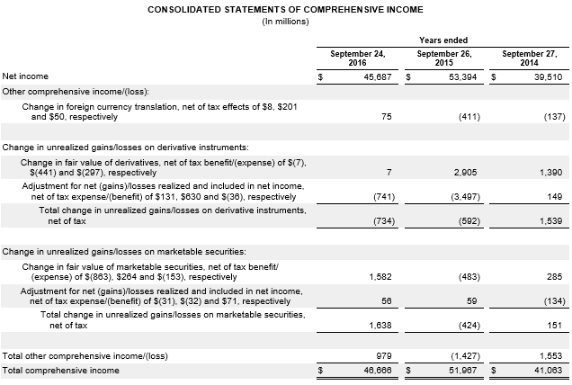
A Closer Look
Both the FASB and IASB require an additional statement, titled the Statement of Comprehensive Income, which can be presented separately or in combination with the income statement.

Slide 31
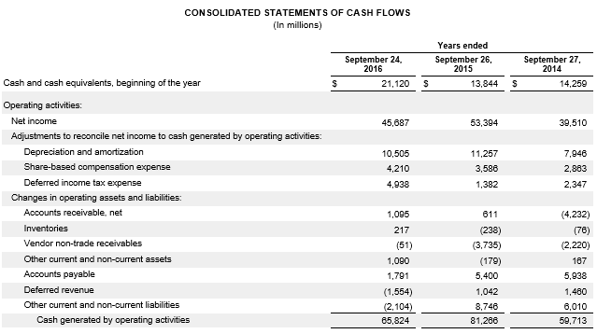
A Closer Look
On the Statement of Cash Flows, Cash Flows from Operating Activities (CFO), can be reported using either the direct or indirect method. The indirect method presents a reconciliation of net income on an accrual basis to cash flows from operations. The Operating Activities section prepared using the indirect method helps the analyst understand the causes of differences between a company’s net income and its cash flows.

Slide 32
Voluntary Disclosures

Slide 33
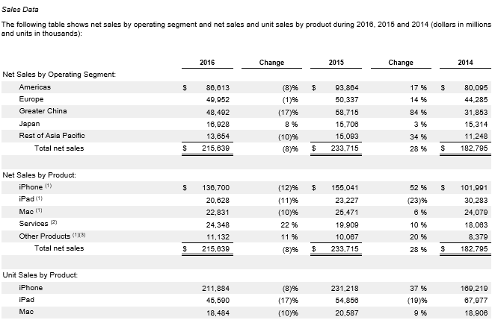
Voluntary Disclosure
GAAP and SEC regulations set only the minimum level of required financial disclosures. Many companies provide important disclosures beyond those required.

Slide 34
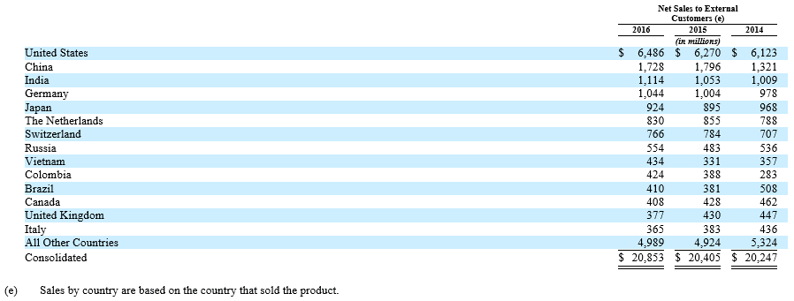

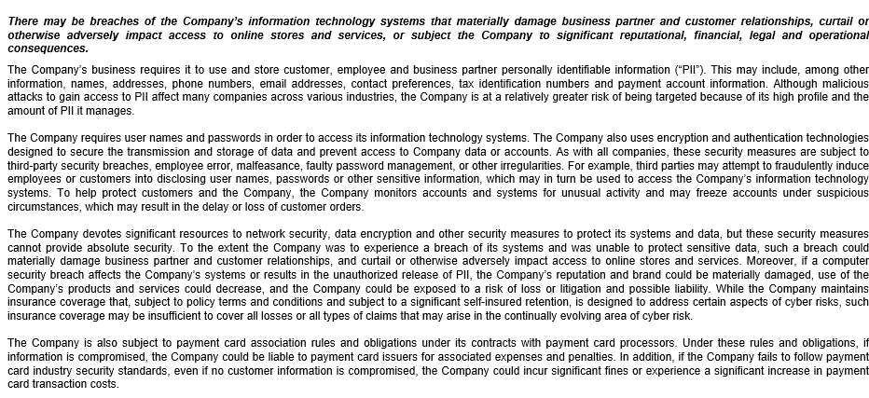
Voluntary Disclosure

Slide 35
Ratio Analysis

Slide 36
Return on Assets
How profitable (effective) is management in using its resources?
In its broadest measure, return on assets (ROA) is calculated by dividing net income by average total assets. Average total assets is the beginning asset balance plus the ending asset balance divided by two.
Return on assets measures how much an organization earns for each dollar of investment in assets. It is a general measure of profitability and management effectiveness, independent of financing strategy.
Organizations with higher ROA are doing a better job of selecting and managing investments, all other things equal. Since it is independent of the source of financing (debt vs. equity), it can be used to evaluate performance at any level within the organization. It is often computed on a division-by-division or product line basis and used to evaluate division or product line managers’ relative performance.
* In more complex ROA analyses, Net Income is adjusted for account for various elements included in (or exclude from) income computations due to various accounting rules.
Net Income*
Average Total Assets
ROA
=

Slide 37
Return on Assets
How profitable (effective) is management in using its resources?
Effective analysis requires understanding why ROA differs both from prior levels and from those of its competitors. ROA profit driver analysis (also called ROA decomposition or DuPont analysis) breaks down ROA into two factors. These factors are often called profit drivers or profit levers because they describe the two ways that management can improve ROA.
Net profit margin measures how much of every sales dollar is profit (operating effectiveness). It can be increased by
Increasing sales volume
Increasing sales price
Decreasing cost of goods sold and operating expenses
Total asset turnover measures how many sales dollars the company generates with each dollar of assets (investing efficiency). It can be increased by
Centralizing distribution to reduce inventory kept on hand.
Consolidating production facilities in fewer factories to reduce the amount of assets necessary to generate each dollar of sales.
ROA
=
Net Profit Margin * Total Asset Turnover
Net Income
Average Total Assets
Net Income
Net Sales
=
Net Sales
Average Total Assets
*

Slide 38
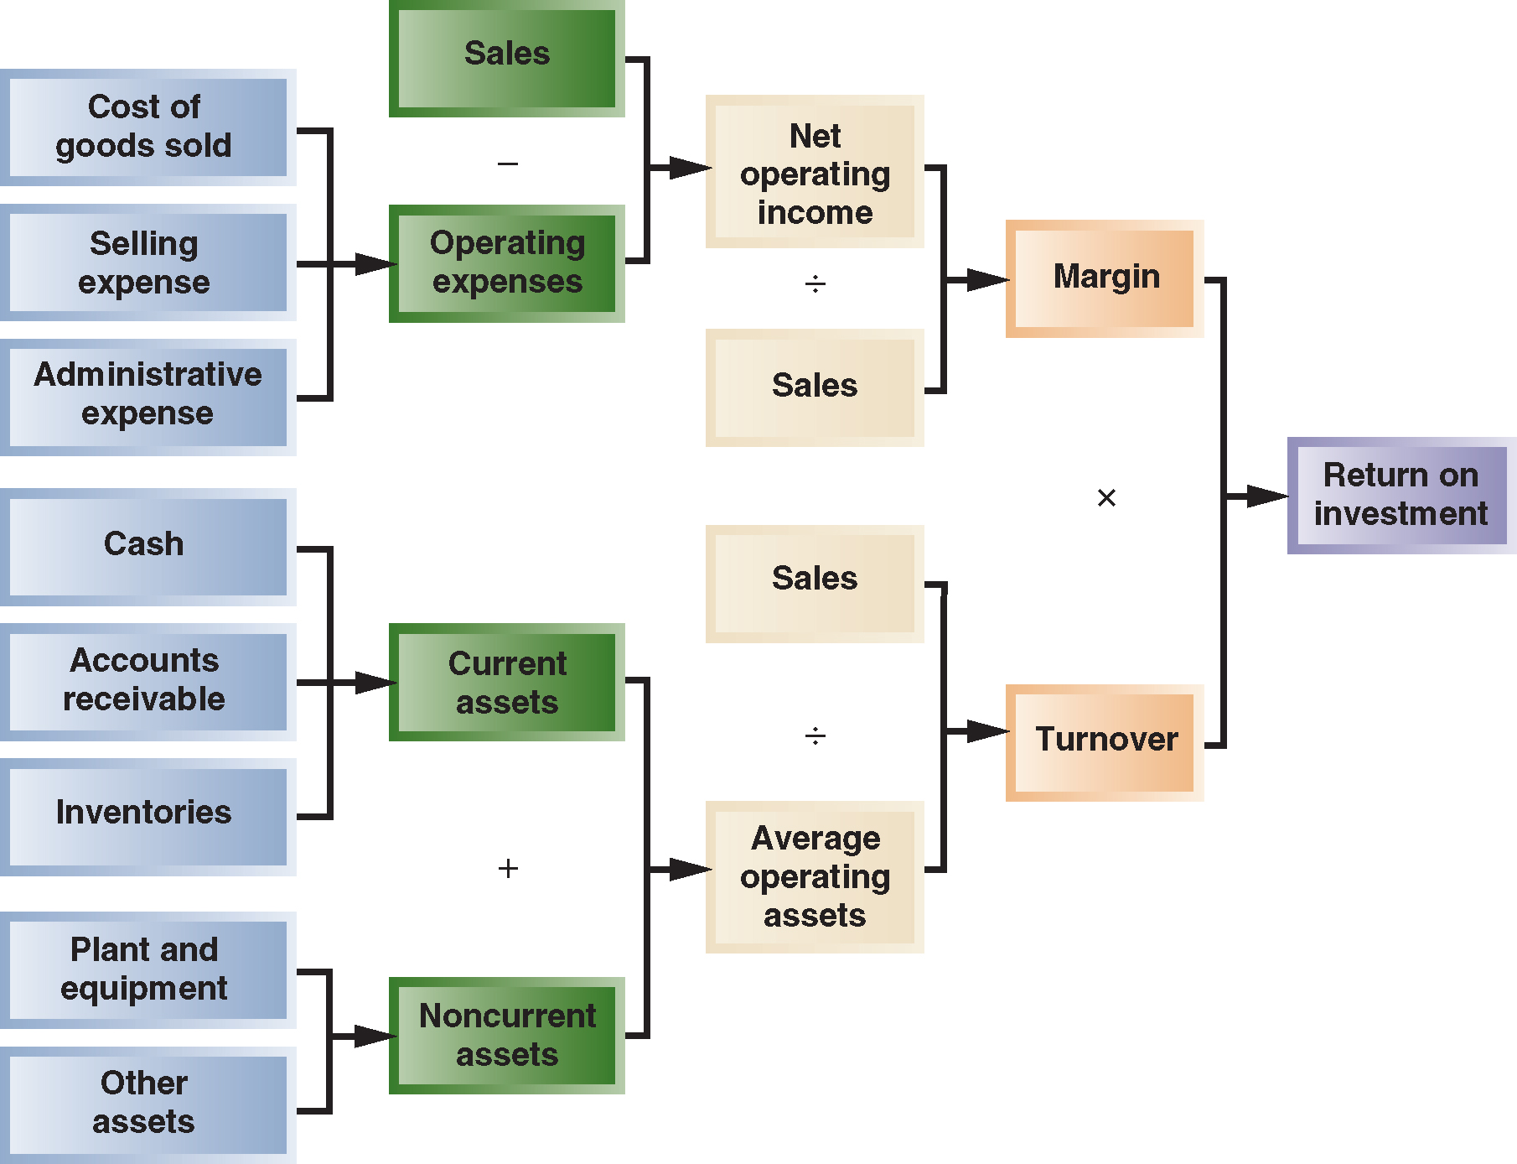
Return on Assets
Return on Assets
DuPont analysis lets managers identify
the key drivers that can boost ROA.

Slide 39
Evaluating Performance

Slide 40
Evaluating Performance
Consultants, executives and corporate directors follow several steps to select the accounting-based performance measures used to evaluate division managers:
Select performance measures that align with executives’ financial goals.
ROI (ROA, ROE, ROIC), Residual Income, EVA
Determine details of each performance measure.
How should these measures be calculated?
Set targets for each performance measure that must be met by an investment center manager.
How should targets be established for each measure?

Slide 41
Select performance measures that align with executives’ financial goals

Slide 42
Evaluating Performance
Select performance measures that align with executives’ financial goals
Why not use (only) Total Shareholder Return (TSR)?
Measures the total return to shareholders of the firm’s stock
Why not use (only) earnings per share (EPS)?
Measures the firm’s “income” scaled by weighted average common shares outstanding
Why not use (only) a measure of accounting income?
Measures subunit revenue minus cost (e.g., non-GAAP measure such as EBIT, EBITDA)

Slide 43
Evaluating Performance
HARIRI HOTELS | San Francisco | Chicago | Pittsburgh | Total
Hotel revenues | $1,200,000 | $1,400,000 | $3,185,000 | $5,785,000
Hotel costs | $ 960,000 | $1,100,000 | $2,675,000 | $4,735,000
Hotel operating income | $ 240,000 | $ 300,000 | $ 510,000 | $1,050,000
Interest costs on long-term debt @ 10% |  |  |  | $ 450,000
Income before income taxes |  |  |  | $ 600,000
Income taxes at 30% |  |  |  | $ 180,000
Net income |  |  |  | $ 420,000
Current assets | $ 400,000 | $ 500,000 | $ 660,000 | $1,560,000
Long-term assets | $ 600,000 | $1,500,000 | $2,340,000 | $4,440,000
Total assets | $1,000,000 | $2,000,000 | $3,000,000 | $6,000,000
Current liabilities | $ 50,000 | $ 150,000 | $ 300,000 | $ 500,000
Long-term debt |  |  |  | $4,500,000
Stockholders’ equity |  |  |  | $1,000,000
Total liabilities and SE |  |  |  | $6,000,000
Suppose Hariri Hotels evaluates hotels using operating income as the performance measure. Which hotel performed “best”?

Slide 44
Evaluating Performance
HARIRI HOTELS | San Francisco | Chicago | Pittsburgh | Total
Hotel revenues | $1,200,000 | $1,400,000 | $3,185,000 | $5,785,000
Hotel costs | $ 960,000 | $1,100,000 | $2,675,000 | $4,735,000
Hotel operating income | $ 240,000 | $ 300,000 | $ 510,000 | $1,050,000
Interest costs on long-term debt @ 10% |  |  |  | $ 450,000
Income before income taxes |  |  |  | $ 600,000
Income taxes at 30% |  |  |  | $ 180,000
Net income |  |  |  | $ 420,000
Current assets | $ 400,000 | $ 500,000 | $ 660,000 | $1,560,000
Long-term assets | $ 600,000 | $1,500,000 | $2,340,000 | $4,440,000
Total assets | $1,000,000 | $2,000,000 | $3,000,000 | $6,000,000
Current liabilities | $ 50,000 | $ 150,000 | $ 300,000 | $ 500,000
Long-term debt |  |  |  | $4,500,000
Stockholders’ equity |  |  |  | $1,000,000
Total liabilities and SE |  |  |  | $6,000,000
Suppose Hariri Hotels uses operating income and total assets to calculate ROA. Which hotel performed “best”?

Slide 45
Evaluating Performance
Hariri Hotels uses operating income and total assets to calculate ROA. Which hotel performed “best”?
San Francisco: $240,000/$1,000,000 = 24%
Chicago: $300,000/$2,000,000 = 15%
Pittsburgh: $510,000/$3,000,000 = 17%
Return on Assets: San Fran, Pittsburgh, Chicago
Operating Income: Pittsburgh, Chicago, San Fran
Although ROA is an improvement over operating income as a performance measure, there are still many weaknesses in using ROA to evaluate performance
Fails to include the cost of equity. Accounting income measures such as net income only capture the cost of debt
Fails to accurately measure operating performance. Accounting income and assets mix operating decisions and financing decisions
Creates a disconnect. Evaluating performance with a measure that is inconsistent with the criteria used to make asset investment decisions (NPV)
Provides incentives to sub-optimize. Investment center managers recognize that division ROA is the weighted average of new projects and historical ROA performance; motivates managers to reject NPV projects that the firm should accept.

Slide 46
Evaluating Performance
Suppose a Hariri Hotels investment center manager reviews a proposal that is estimated to generate operating income of $80,000. This represents a 20% increase over current operating income.
The proposal requires a $500,000 asset investment above the current level of $2 million in assets. The proposal alone will have an ROA of 16%, well above the firm’s cost of capital. The manager’s variable compensation (i.e., bonus) is based on improving year-over-year ROA.
Why might the manager reject the project despite the ROA exceeding the firm’s cost of capital?
Current ROA
Income: $400,000 ($80,000 / 20%)
Assets: $2,000,000
ROA: 20%
New ROA
Income: $480,000 ($400,000+$80,000)
Assets: $2,500,000 ($2,000,000+$500,000)
ROA: 19.2%
Note: This weighted-average property of a ratio contributes to a lack of goal congruence; a manager has an incentive to reject the project despite its positive benefits for the firm
The combined ROA would be less than the ROA of last year (19.2% < 20%)
The manager rejects the project

Slide 47
Ratio Analysis: Transaction Effect

Slide 48
Effect of Transactions on Ratio Analysis
Managers know that investors and creditors follow their key financial ratios closely. Changes in ROA and its components can have a major effect on a company’s stock price and interest rates that lenders charge. As a consequence, company managers closely follow the effects of their actual and planned transactions on these same key financial ratios.
Consider the following example pertaining to Apple Inc.:
The following figures (in millions) are taken directly from Apple’s financial statements:
Net Income: 45,687
Net Sales: 215,639
Current Assets: 106,869
Total Assets (average): 306,016
Current Liabilities: 79,006

Slide 49
Effect of Transactions on Ratio Analysis
Example 1A:
Apple incurred an additional $1 billion in research and development (R&D) expense paid for in cash.
What would be the effect on net profit margin?
Note that the transaction would decrease the numerator (Net Income) and have no effect on the denominator (Net Sales)
The ratio was 0.212; it would decrease to 0.207
 | (in millions) | Debit | Credit
(1a) | R&D expense (+E; -SE) | 1,000
 | Cash (-A) |  | 1,000
 | Net Income | ÷ | Net Sales | = | Net Profit Margin
As reported: | 45,687 | ÷ | 215,639 | = | .212
Transaction: | (1,000) |  | -
After transaction: | 44,687 | ÷ | 215,639 | = | .207

Slide 50
Effect of Transactions on Ratio Analysis
Example 1B:
Apple incurred an additional $1 billion in research and development (R&D) expense paid for in cash.
What would be the effect on return on assets?
Note that the transaction would decrease the numerator (Net Income) by $1,000 and also decrease the ending total assets by $1,000 but have no effect on beginning total assets. So the denominator, average total assets, would only decrease by $500
ROA was 14.93%; it would decrease to 14.63%
 | (in millions) | Debit | Credit
(1b) | R&D expense (+E; -SE) | 1,000
 | Cash (-A) |  | 1,000
 | Net Income | ÷ | Avg. Total Assets | = | ROA
As reported: | 45,687 | ÷ | 306,016 | = | 14.93%
Transaction: | (1,000) |  | (500)
After transaction: | 44,687 | ÷ | 305,516 | = | 14.63%

Slide 51
Effect of Transactions on Ratio Analysis
Example 2:
Apple paid $4 billion of accounts payable in cash.
What would be the effect on the current ratio?
Note that the transaction would decrease the numerator (Current Assets) and the denominator (Current Liabilities) by the same amount
Current Ratio was 1.35; it would increase to 1.37
 | (in millions) | Debit | Credit
(2) | Accounts Payable (-L) | 4,000
 | Cash (-A) |  | 4,000
 | Current Assets | ÷ | Current Liabilities | = | Current Ratio
As reported: | 106,869 | ÷ | 79,006 | = | 1.35
Transaction: | (4,000) |  | (4,000)
After transaction: | 102,869 | ÷ | 75,006 | = | 1.37
NOTE: If a transaction affects the numerator and denominator of the ratio by the same amount, the effect will depend on whether the original ratio value was greater or less than 1.00

Slide 52
End of Chapter 05

